Slide 1

Battle of Deepfake Diffusion vs. Recognition
矛盾大對決 深偽 生成 VS 辨識
Jerry-StanCode創辦人
Mentor
Members 葉羽容 汪庭嫣 李沛穎 葉泓揚

Slide 2
Introduction
The Turing Eye
(SC201 Oct2023)
Dataset
Portrait 480
Midjourney 480
Stable Diffusion 480
Bing 240
ResNet
- VAL Acc 90.7%
- TEST Acc 92.1%

Slide 3
Introduction
Generation Team
Understand Diffusion Model and use Stable Diffusion to generate test images.
Recognition Team
Use Portrait & Stable Diffusion dataset.
Multi-model ensemble
(Resnet/ DenseNet/ EfficientNet/ Vision Transformer)
Adjust the test images to decrease accuracy.

Slide 4
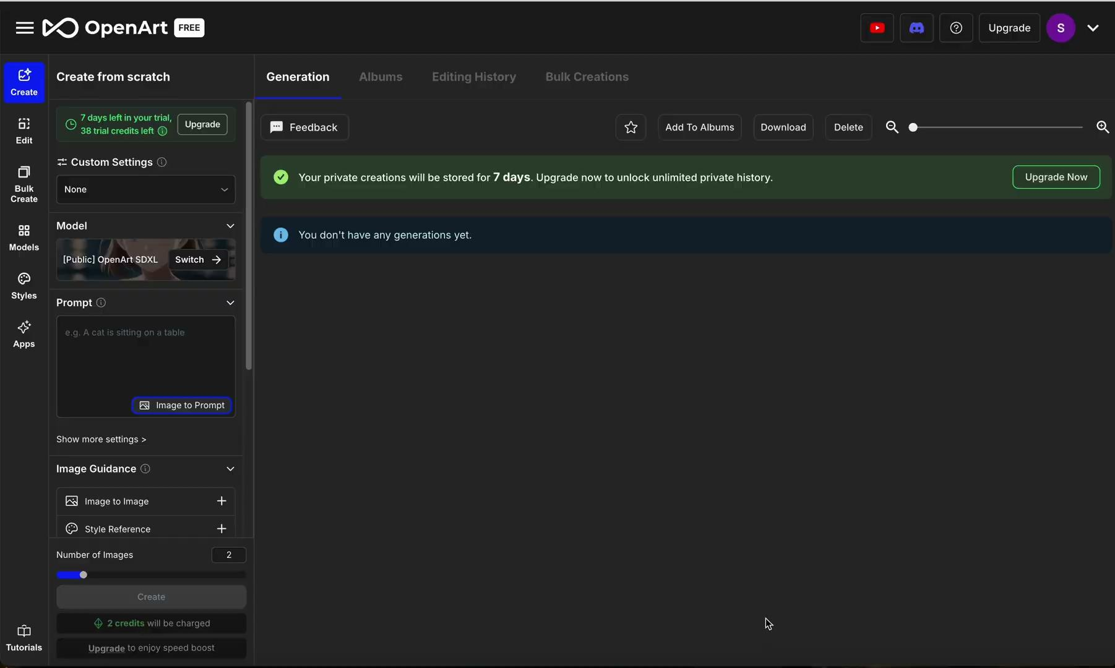
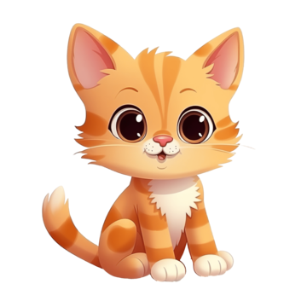

What is Stable Diffusion ?
Image generative AI
How to use?
1. Enter prompt
2. Create image
A cute
cat.
Notes:
那接下來將由我簡單介紹Stable Diffusion背後的演算法，但由於此演算法複雜且運算量龐大，我們並沒有手刻，接下來的介紹也只會著重在概念講解，不過對細節有興趣的人也別失望，因為我們在ＰＰＴ中有提供很多參考資料讓大家會後能進一步研究。好，那一開始帶大家實際使用看看如何Stable Diffusion 生成圖像。首先使用者要在stable diffusion的平台上先輸入prompt，然後ＡＩ就會根據所接受到的Ptompt去生成相對應的圖像。那不知道大家是否會好奇ＡＩ是如何看懂prompt並且生成正確的圖像呢？

Slide 5
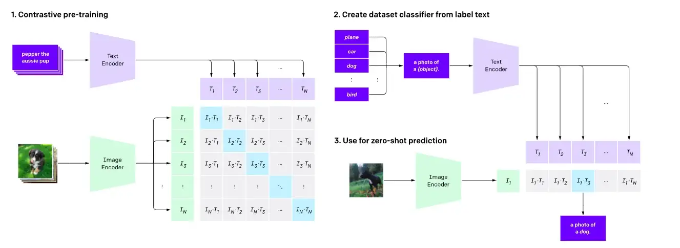
Contrastive Language-Image Pretraining
(Clip Model)
Reference: https://openai.com/index/clip/
Notes:
也就是透過由Open AI於2021年發表一篇paper當中所提出的clip模型，clip模型簡單來說就是一個用於對比文字與圖像的模型，Open AI 從網路上收集大量文本與圖像並他們訓練成一個巨大的樣本，對角線藍色框框的部分稱為正樣本，因為他是100%正確配對文本與圖像，其餘部分則稱為副樣本。（加入空白）而透過這個預先訓練好的clip模型就可以達到zero-shot prediction也就是所謂的零樣本預測，換句來說就是模型可以為一張完全沒見過的新圖像預測最適合的文本。那對其他細節有興趣的人建議可以直接去看OpenAI的paper，連結已放在PPT上提供給大家。

Slide 6
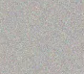
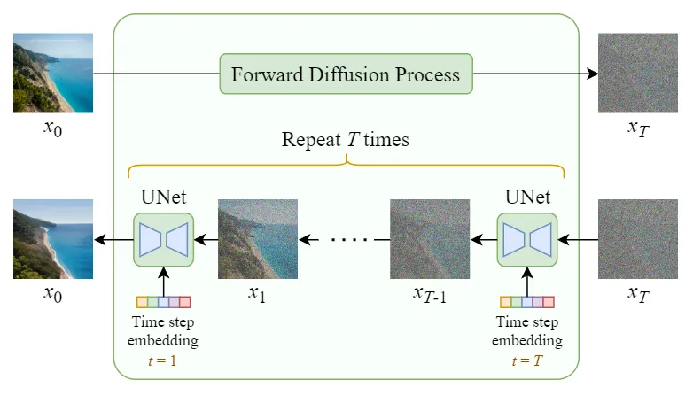
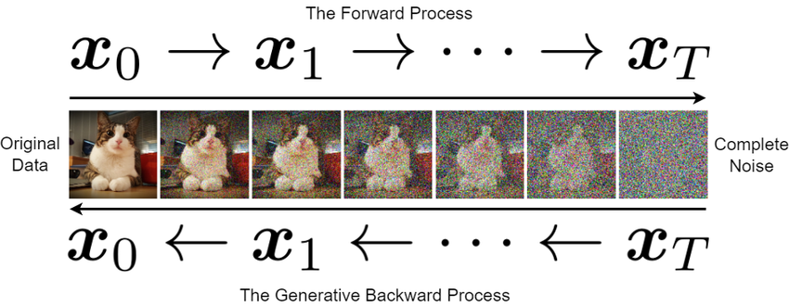
How do the diffusion model learn to generate an image ?
Noise Scheduler
Reverse Diffusion Process
This is also how Stable Diffusion create an image.
Reference: https://medium.com/@steinsfu/stable-diffusion-clearly-explained-ed008044e07e#3212
Notes:
再來，我們需要了解Diffusion Model是如何去學習生成一張圖像的？以最簡單直接的方式來介紹，那就是模型會對一張原始圖檔一點一點增加雜訊直到整張圖檔完全變成雜訊，此過程也稱為Noise Scheduler，接著模型會再做反轉過程，也就是Reverse Diffusion Process。利用一種叫U-net的方法一步一步去除雜訊直到生成跟原始圖檔接近的圖像為止。而這種一點一點增加雜訊或一步一步去除雜訊的步驟我們稱為Time steps，因為可以把它想成是有時間軸順序的。

Slide 7
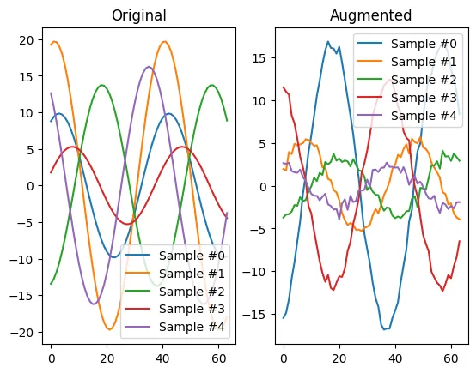
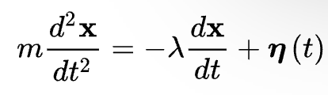
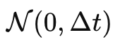
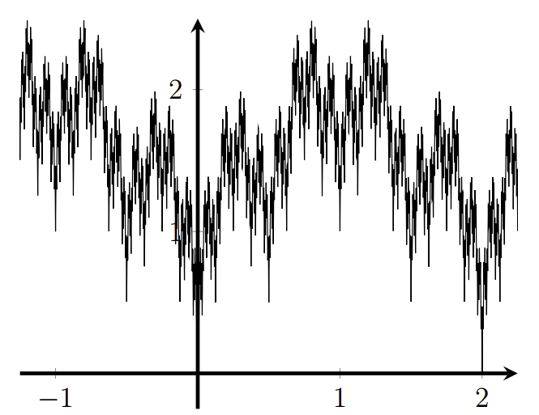
Gaussian Noise Augmentation
Steps:
Langevin equation (Brownian motion)
Gaussian Distribution
Until it becomes continuous but nowhere differentiable
Original time series and synthetic data generated via Jittering
Reference: https://towardsdatascience.com/time-series-augmentations-16237134b29b#:~:text=The%20idea%20behind%20Gaussian%20noise,samples%
20or%20improves%20predictive%20performance. & https://en.wikipedia.org/wiki/Langevin_equation
Notes:
這裡簡單介紹其中一種增加雜訊的方法稱為Gaussian Noise Augmentation，就是將數學函數的一次微分項加上一個Gaussian distribution正態分佈之後要等於此函數的二次微分項，這會攘函數產生震幅，而此步驟會一直repeat直到函數能夠保持連續特性但再也找不到可微分的地方為止，這時函數就會呈現高頻繁震動但依然是連續函數。

Slide 8
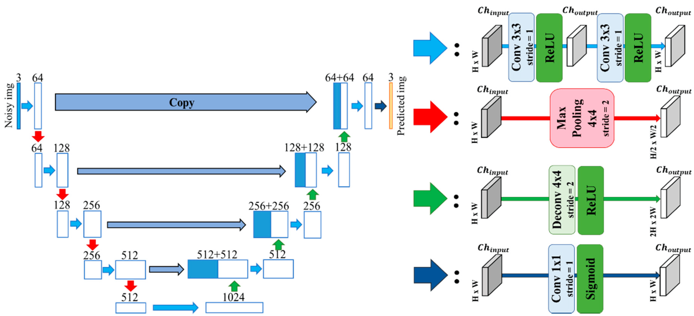
U-Net denoising
Encoder
Decoder
Skip Connection
8 | 7
6 | 5
8 | 8
8 | 8
8
8
Max Pooling
ConvTranspose
Reference: https://www.youtube.com/watch?v=I9MPzQCd4o4 & Source: Google Image
Notes:
再來介紹U-net，U-net是一種生成圖像的方法可以用來去除圖像雜訊也可以用於分割圖像，如果大家對U-net的詳細說明有興趣建議去看放在ＰＰＴ上的參考影片，Jerry會教大家如何手刻U-net，那U-net的簡單介紹就是在encoder部份會透過Maxpooling取出重點特徵不過同時圖像的長寬也會減半，所以在decoder的部分就會透過upsampling來放大重點特徵並將圖像還原至原本相同的大小，且同時透過skip connection與來自encoder的原始特徵合並。這有助於恢復圖像細節和保持圖像連貫的整體性。

Slide 9
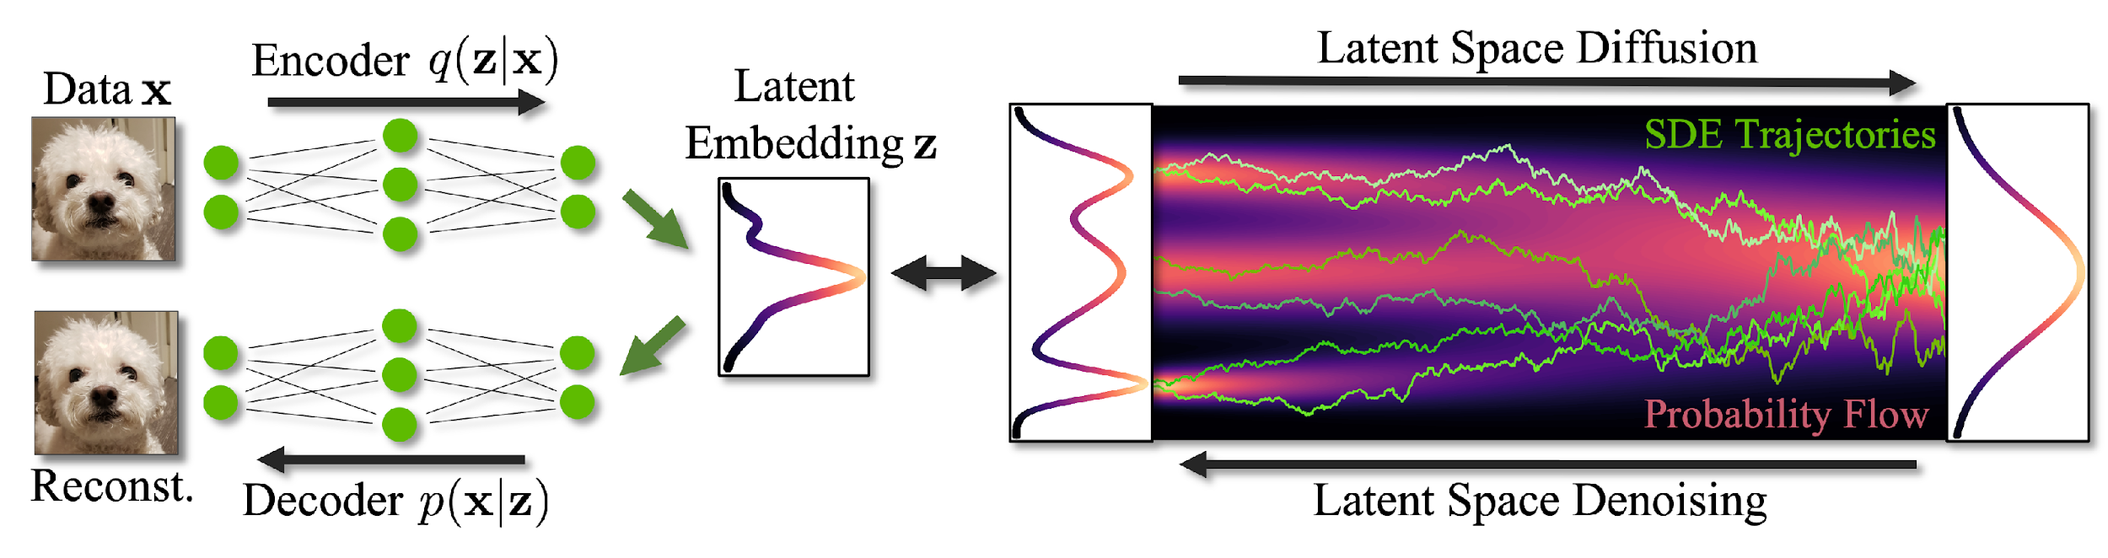
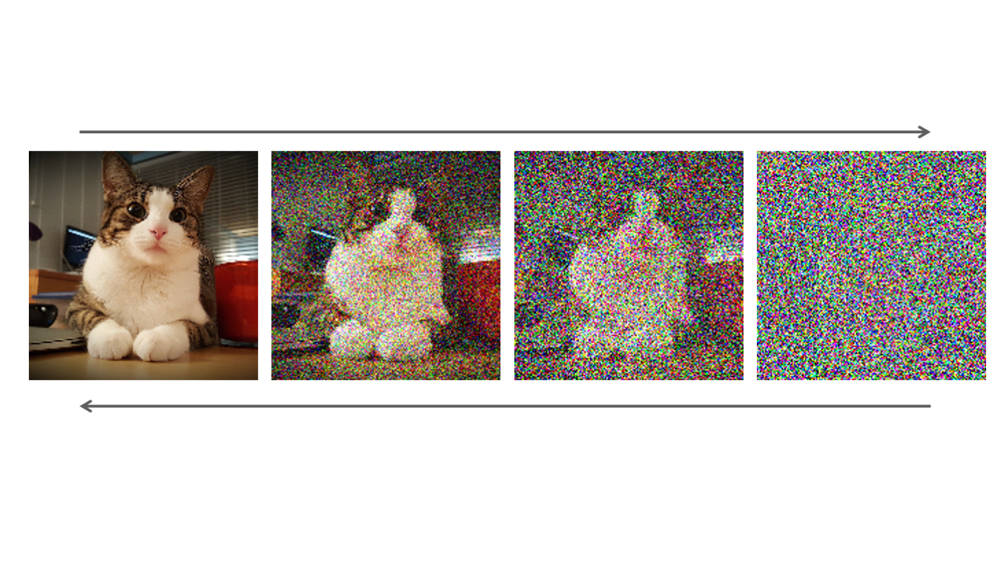
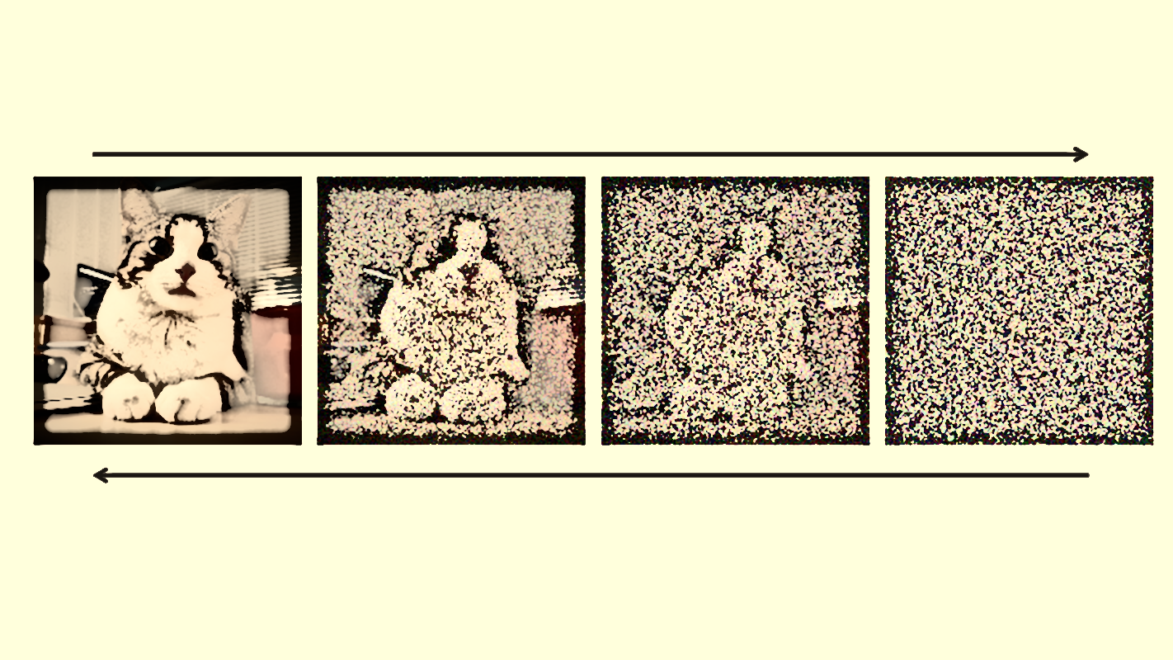
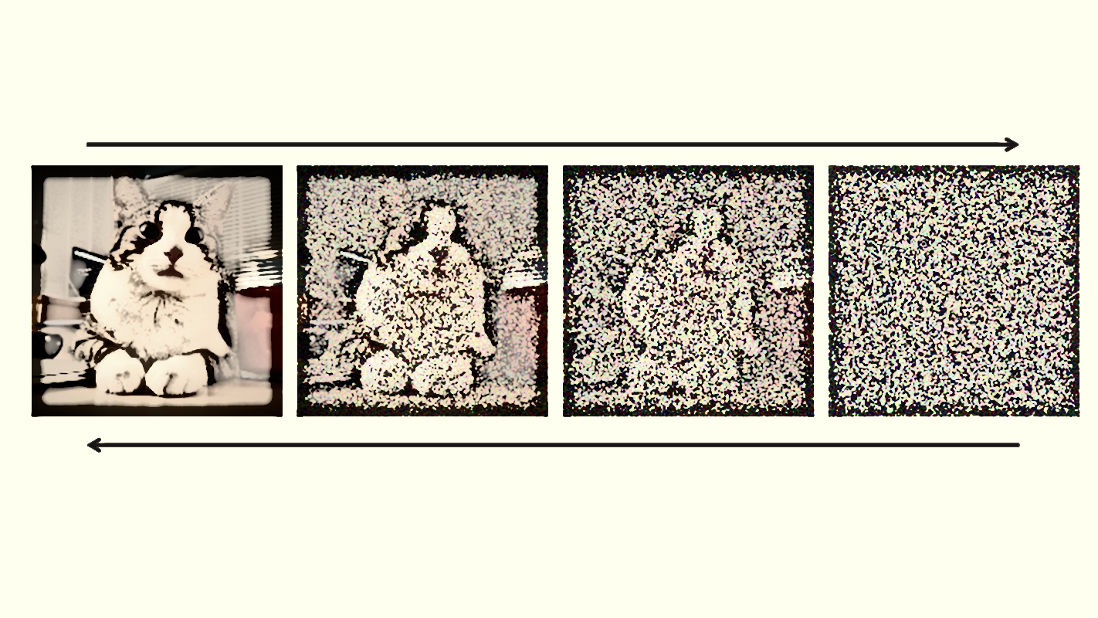
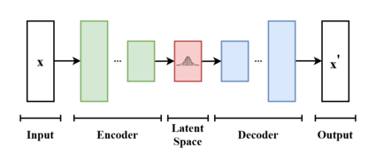
Pure Diffusion Model V.S. “ Latent Diffusion Model “
Latent EmbeddingＺ
Variational Autoencoders (VAEs)
Reference: https://www.youtube.com/watch?v=Dmm4UG-6jxA&list=PLtBw6njQRU-rwp5__7C0oIVt26ZgjG9NI&index=5
Reference: https://www.youtube.com/watch?v=VELQT1-hILo
Source: Google Image
Notes:
以上所介紹的Diffusion Model又可以稱作Pure Diffusion Model，因為它在實際操作上是不可行的，一張圖像的Pixel可能有幾百萬個，這對電腦的運算量來說實在是太大了，所以實際上會使用的是Latent Diffusion Model，也就是在幫圖像增加雜訊之前先透過一種算機率分佈的Encoder將圖像降維成Ｚ空間，再讓模型去跑學習生成此圖像的流程，且在學習完後再透過Decoder將Ｚ空間升維回原本圖像大小。這種先幫圖像降維再升維的方法稱為Variational Autoencoders或VAE，讓對VAE有興趣的人歡迎參考ＰＰＴ上附上的影片，一個是ＭＩＴ的公開課程，另一個則是在教如何手刻VAEs

Slide 10


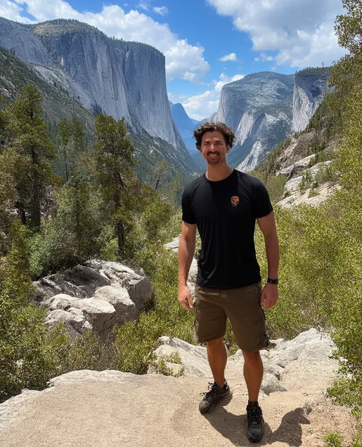
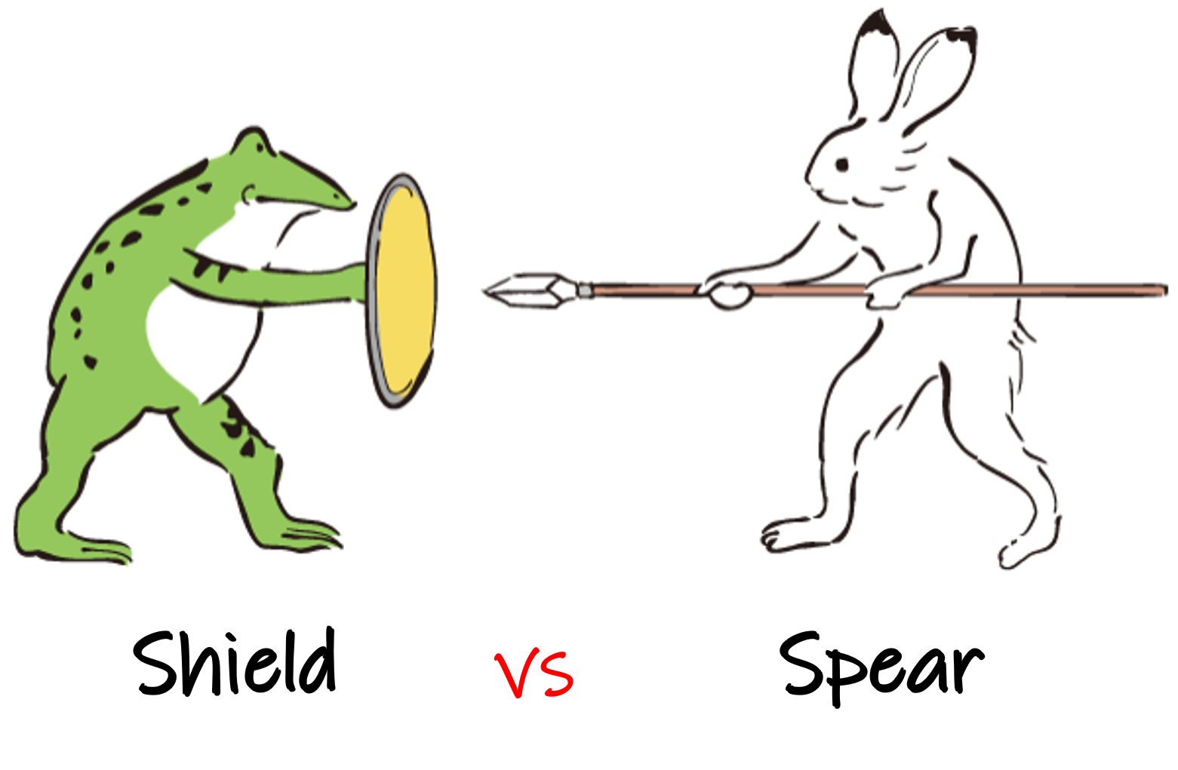
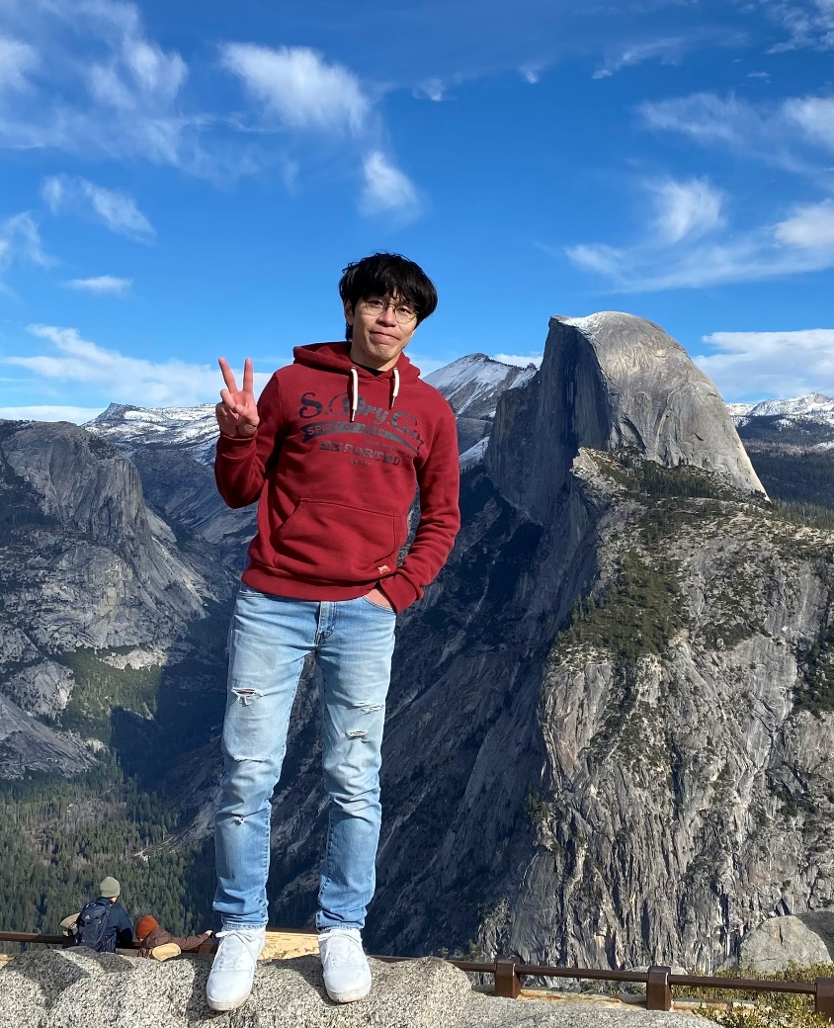


Beginning of the Project
It’s fake!
Do you know which of us is fake?
`
Model
`
Model
That’s true!
`
Model

Slide 11
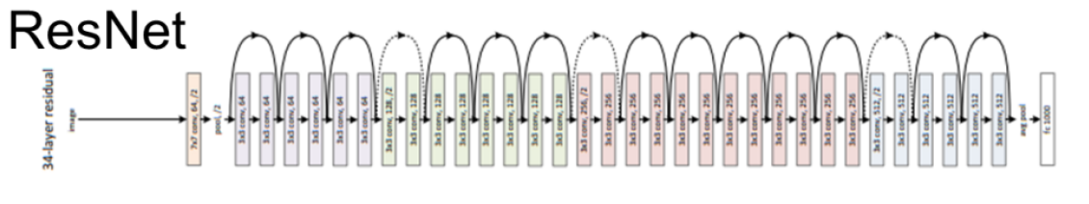
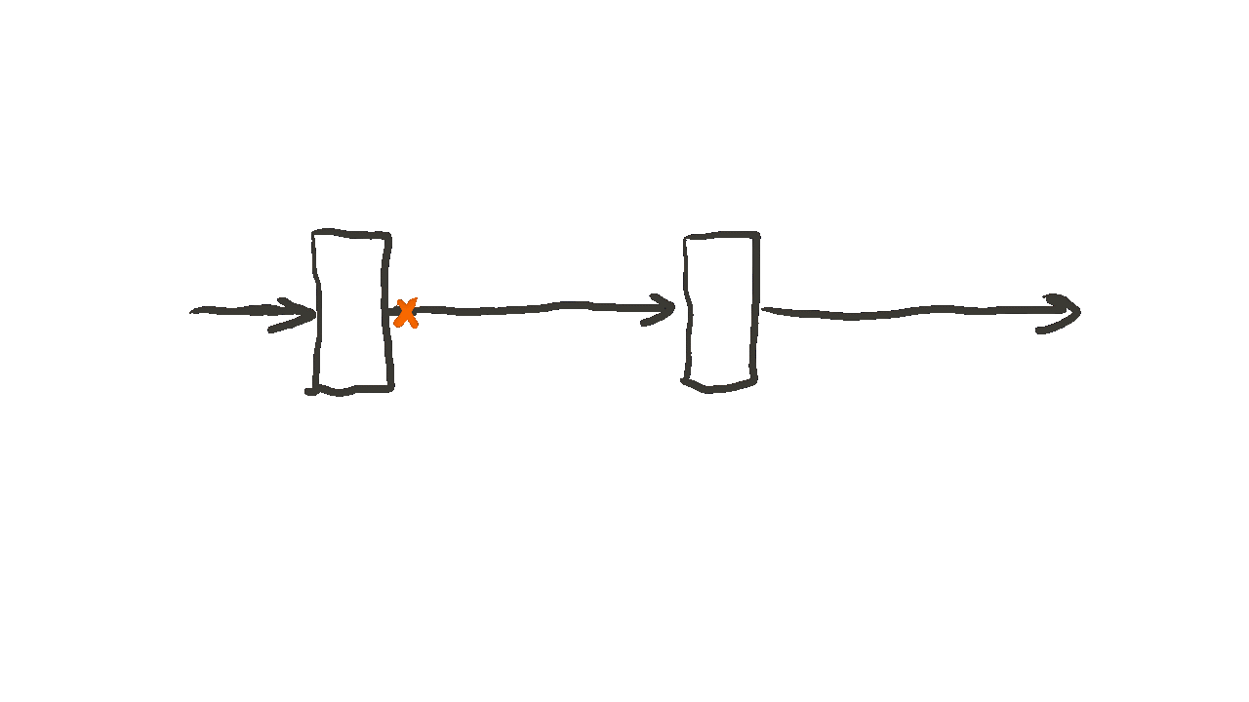
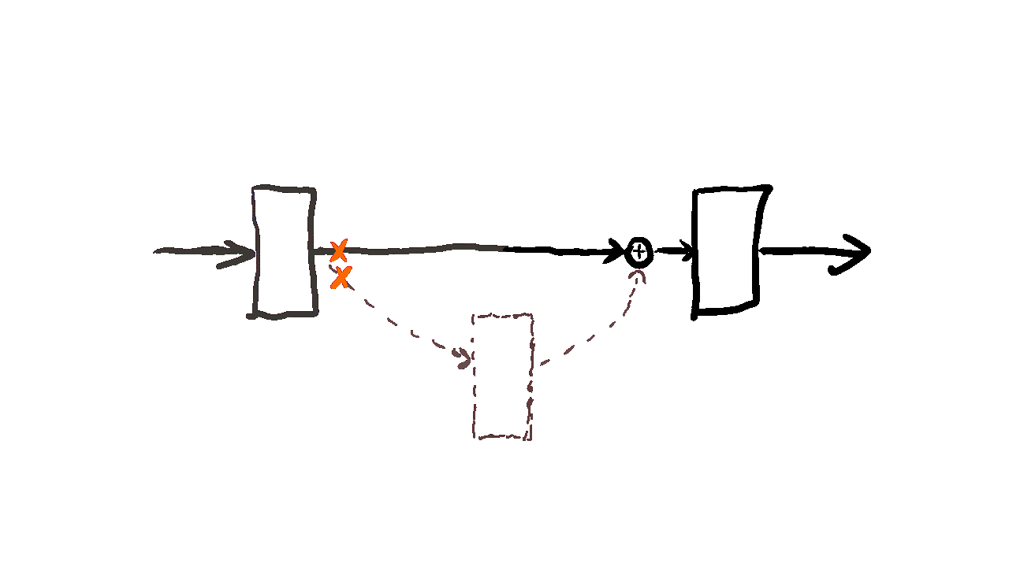
Models we have tried (ResNet)
What did ResNet do?
Skip-connection!
skip-connection
Benefits: It solves the problem of gradient disappearance, allowing the model to be very deep.
Image Reference: (Neural Networks) How ResNet works, a GIF animation/illustration. No Code. | by EasyLearn.AI | Medium

Slide 12


Models we have tried (ResNet with avg pooling)
Diagram for CNN
Avg
Pooling
Avg
Pooling
Max
Pooling
Max
Pooling
Convolution
Convolution
Fully
Connected
Fully
Connected
Output Predictions
Max Pooling
Local features & Object detection
Avg Pooling
Global features & Background information
Image Reference: [資料分析&機器學習] 第5.1講: 卷積神經網絡介紹(Convolutional Neural Network) - JamesLearningNote - Medium

Slide 13
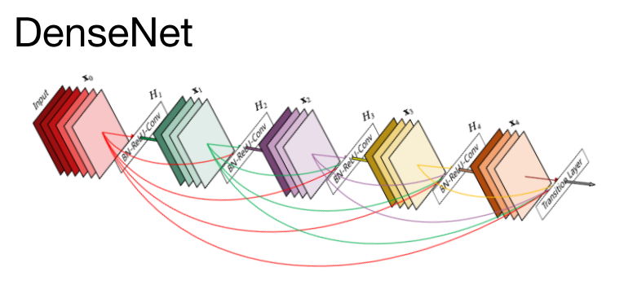
Models we have tried (DenseNet)
What did DenseNet do?
The output of each layer is connected to each subsequent layer.
In other words, the output of each layer is not only passed to the next layer, but also to all subsequent layers.

Slide 14

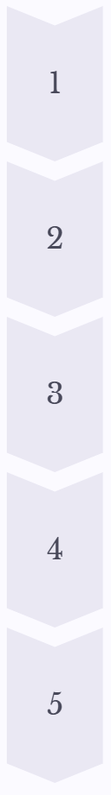
Models we have tried (ViT)
What did Vision Transformer do?
Image Input
An image is taken as input and divided into patches.
Patch Embedding
Each patch is transformed into a vector representation.
Positional Encoding
Spatial information is added to the patch embeddings.
Transformer Encoder
Multiple layers of attention mechanisms process the encoded patches.
Output
The final output is a representation of the image that can be used for various downstream tasks.
Image Reference: Transformers for Image Recognition at Scale (research.google)

Slide 15
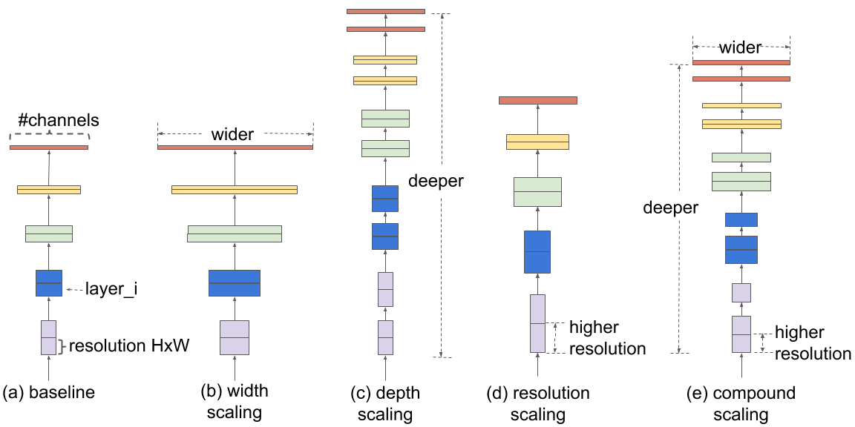

Models we have tried (EfficientNet)
wider
More filter
More features
{
deeper
More layers
More complex
resolution
Increase input
More detail
Compound
High Efficiency!
Image Reference: EfficientNet: Improving Accuracy and Efficiency through AutoML and Model Scaling (research.google)

Slide 16
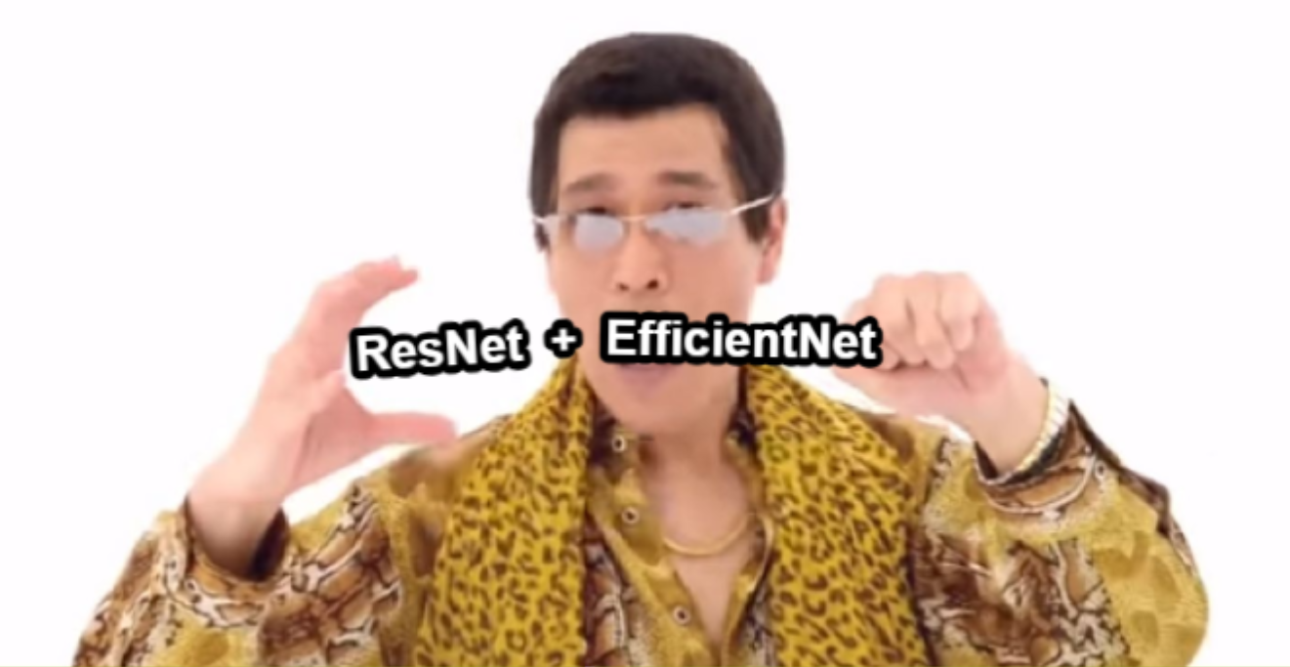

Models we choose
Ensemble model
Shield

Slide 17
Recognition Result
 | Model | Resize | LR | Batch Size | Epochs | Val Acc | Test Acc (Turing) | Test Acc
1 | ResNeXt | 224 | 1e-4 | 16 | 30 | 90% | 86.25% | 74%
2 | ResNet50 | 224 | 1e-4 | 16 | 10 | 87.5% | 88.75% | 82%
3 | DenseNet121 | 224 | 1e-4 | 16 | 20 | 88.75% | 90% | 81.75%
4 | VisionTrans | 224 | 1e-4 | 16 | 20 | 76.4% | 75.0% | 71.5%
5 | ResNet50(avg) | 224 | 1e-3 | 16 | 200 | <70% | <70% | <50%
6 | VisionTrans | 224 | 1e-4 | 16 | 40 | 74.3% | 77.9% | 67.0%
7 | EfficientNet_b0 | 224 | 1e-4 | 16 | 20 | 95% | 88.75% | 83.25%
8 | EfficientNet_b4 | 224 | 1e-4 | 16 | 20 | 93% | 88.75% | 84%
# Data pre-processing
1.T.RandomHorizontalFlip(p=0.5)
2.T.RandomAutocontrast()
3.T.ColorJitter(brightness=0.2, contrast=0.2, saturation=0.2, hue=0.1)
4.T.RandomRotation(10)

Slide 18
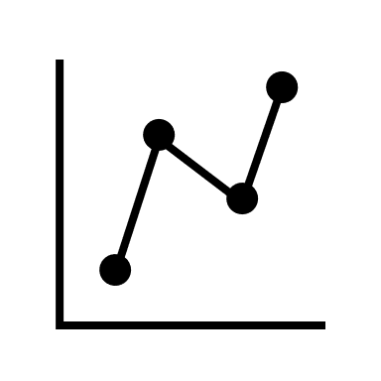
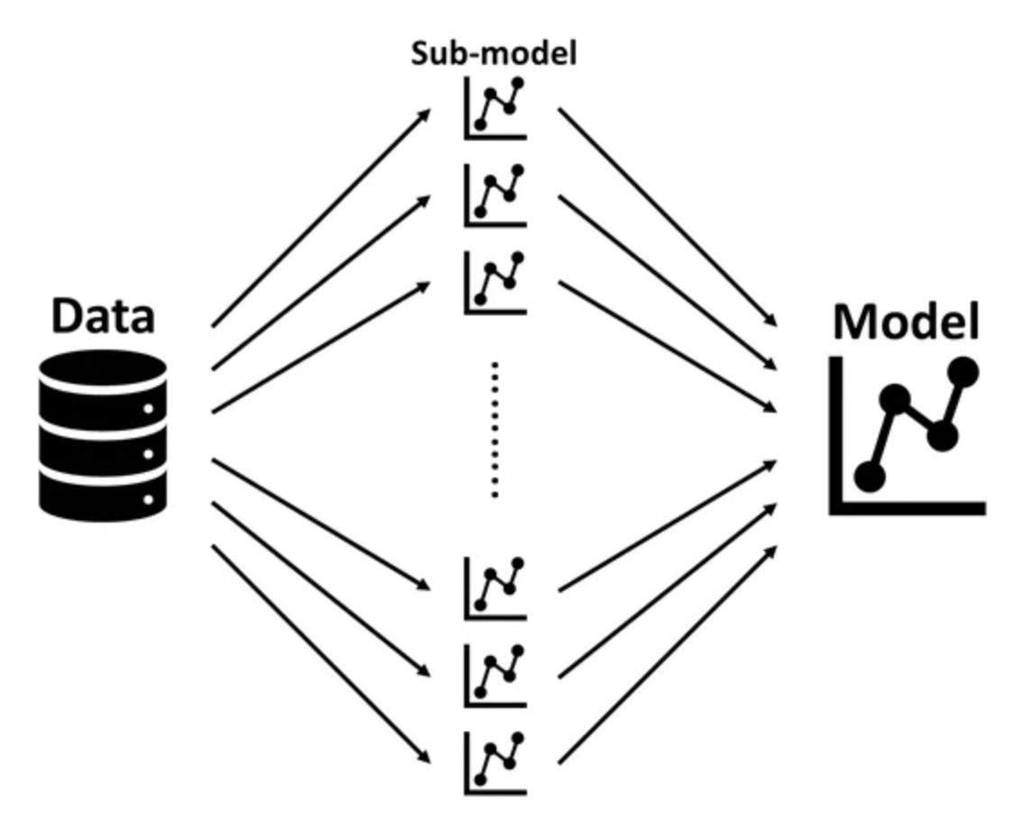

Ensemble models
Why Choose Ensemble Models?
ResNet50
Test
EfficientNet-B4
Ensemble_Acc: 86.75%
EfficientNet-B0

Slide 19
Ensemble models
step
step1:訓練個別模型
step2:保存模型權重
step3:載入訓練好的模型
step4:進行集成預測
step5:使用測試數據測試
step6:評估準確率
Number of new test:
400
Ensemble_Acc:
86.75%

Slide 20
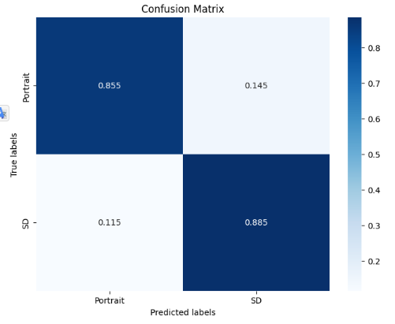
Adjust Test Data
0.855
Ensemble Acc: 87.00%
Portrait: 85.5%
Stable Diffusion: 88.5%
0.885

Slide 21
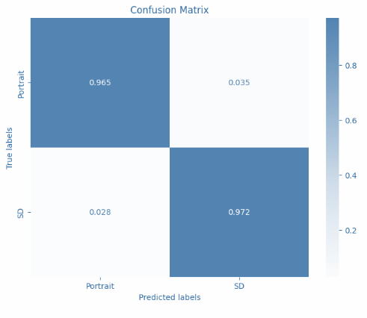
Choose Correct Classified Images
(Only Correct)
0.965
Ensemble Acc: 96.83%
Portrait: 96.5%
Stable Diffusion: 97.2%
0.972

Slide 22
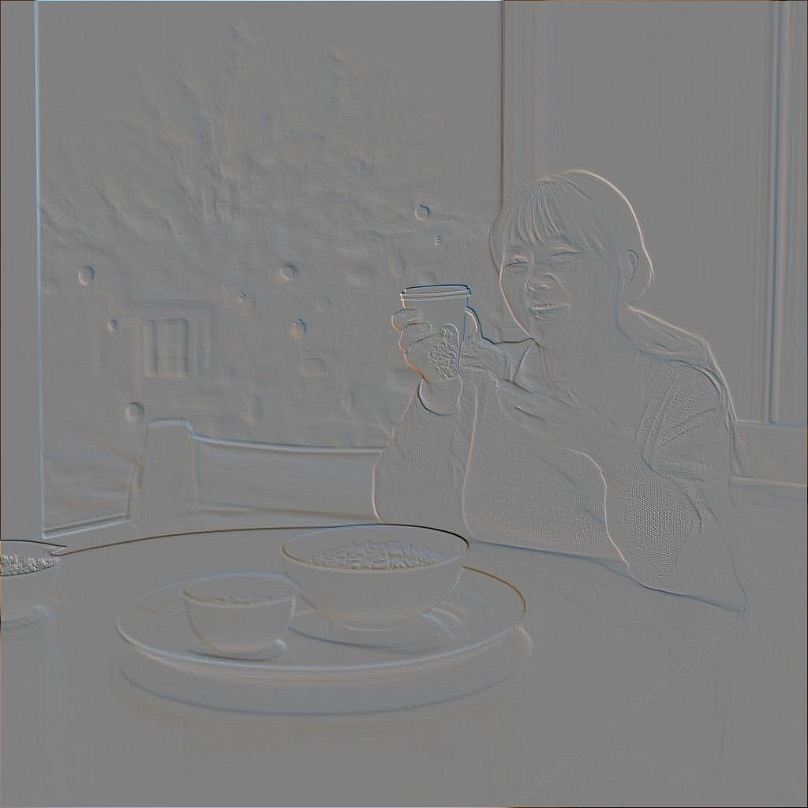
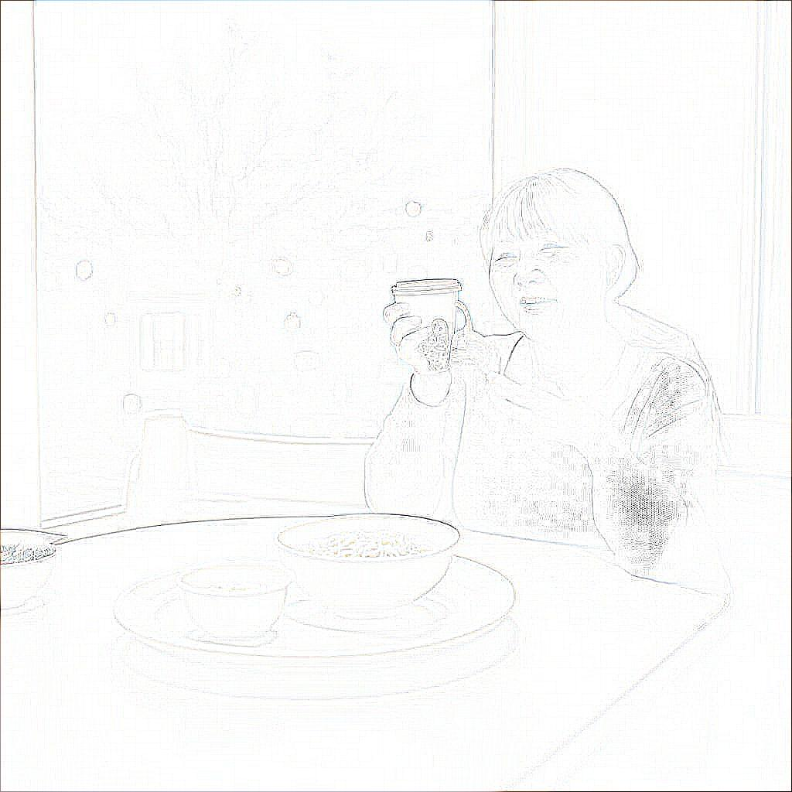
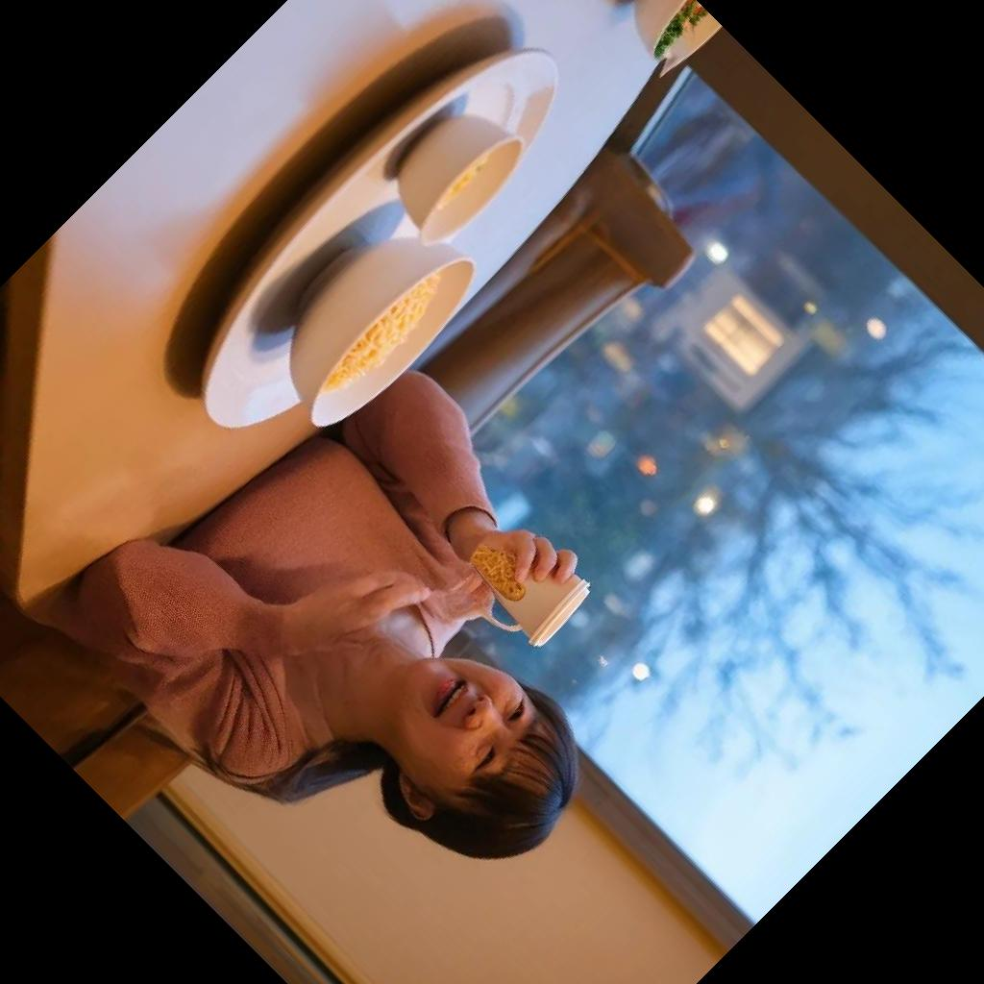
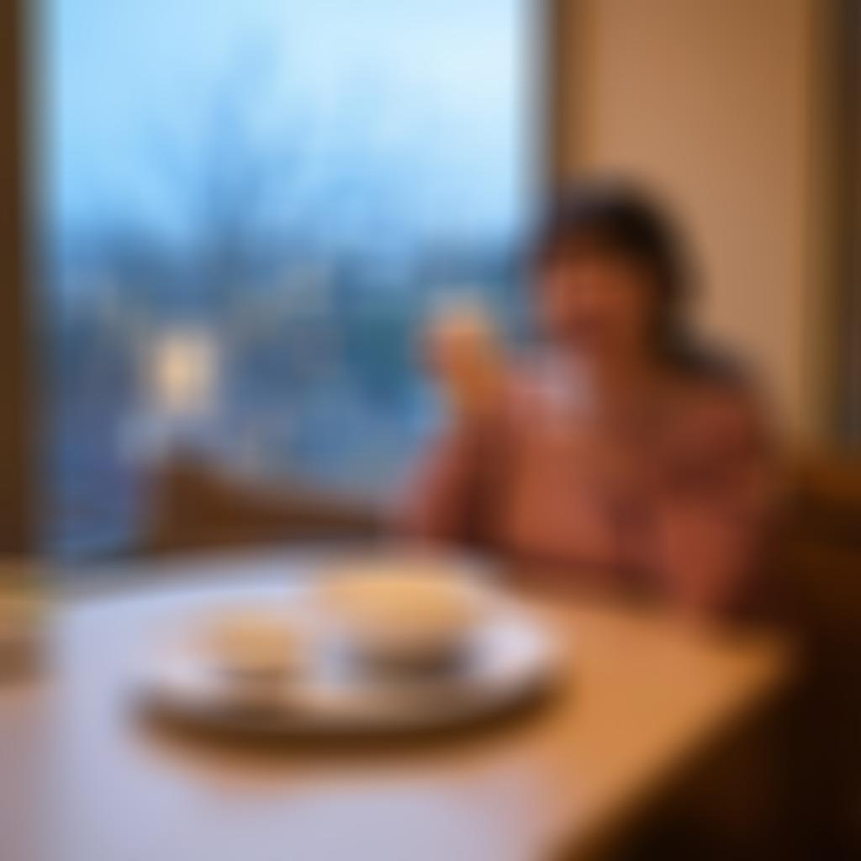
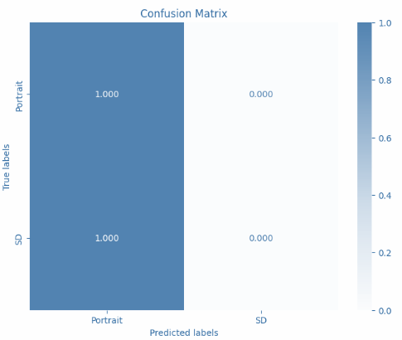
1 - Non Effective
(Only Correct)
1.00
1.00

Slide 23
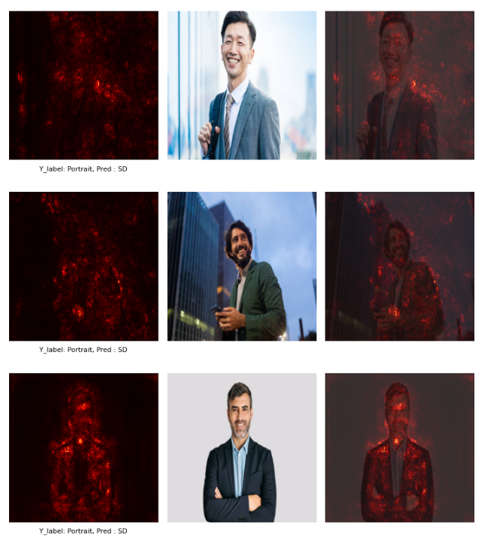
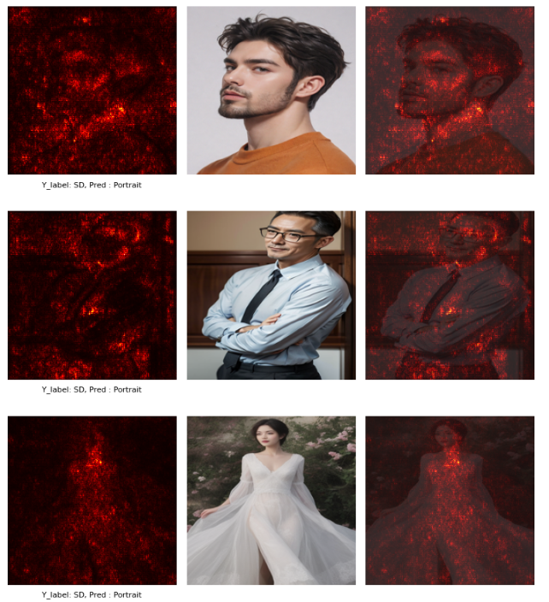
Saliency Map
Portrait
Stable Diffusion

Slide 24
2 – Little Effective
Portrait
Contrast ↓
Highlight Shadow ↓
Colorless
Blur
Stable Diffusion
Contrast ↑
Highlight Shadow ↑
Colorful
Sharp

Slide 25
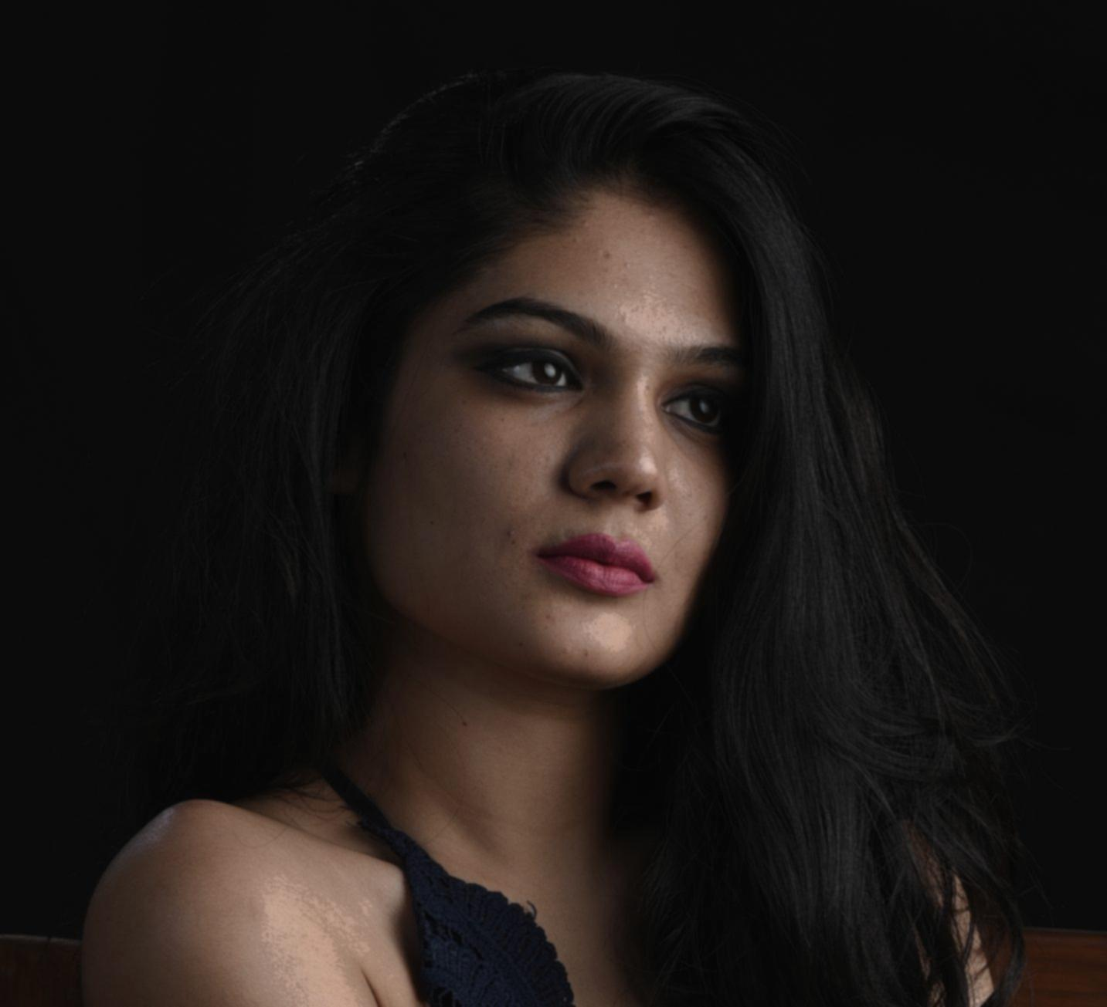
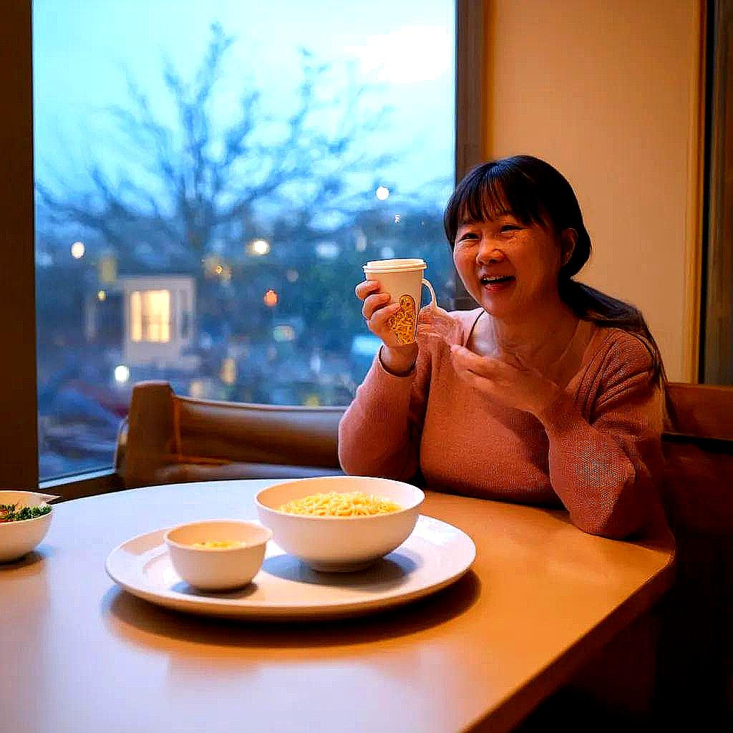


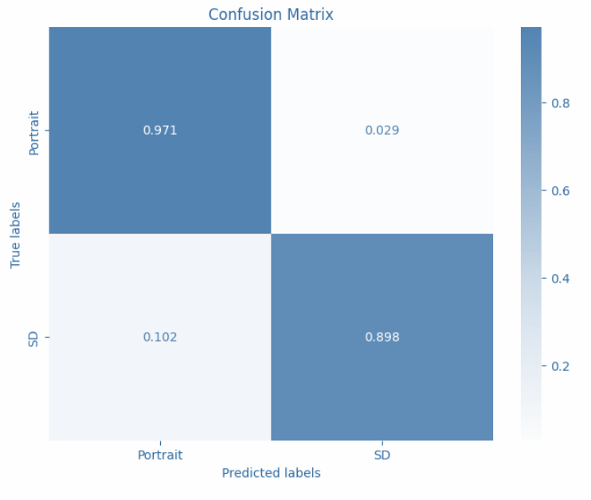
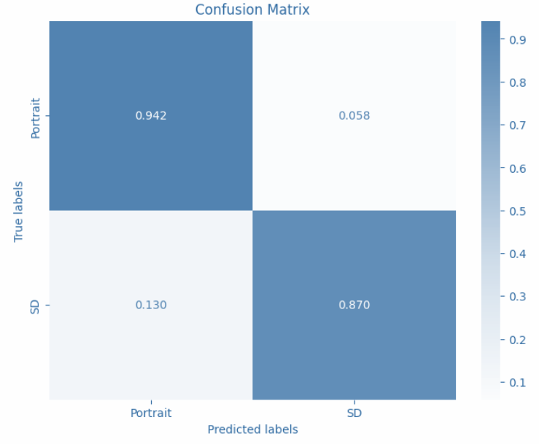
2 – Little Effective
Sharp SD Blur Portrait
Sharp SD Blur Portrait + save 45%
Correct Only:
96.83%
Total: 93.39%
Save 45%
Total: 90.52%
(Only Correct)
(Only Correct)
0.971
0.942
0.898
0.870

Slide 26

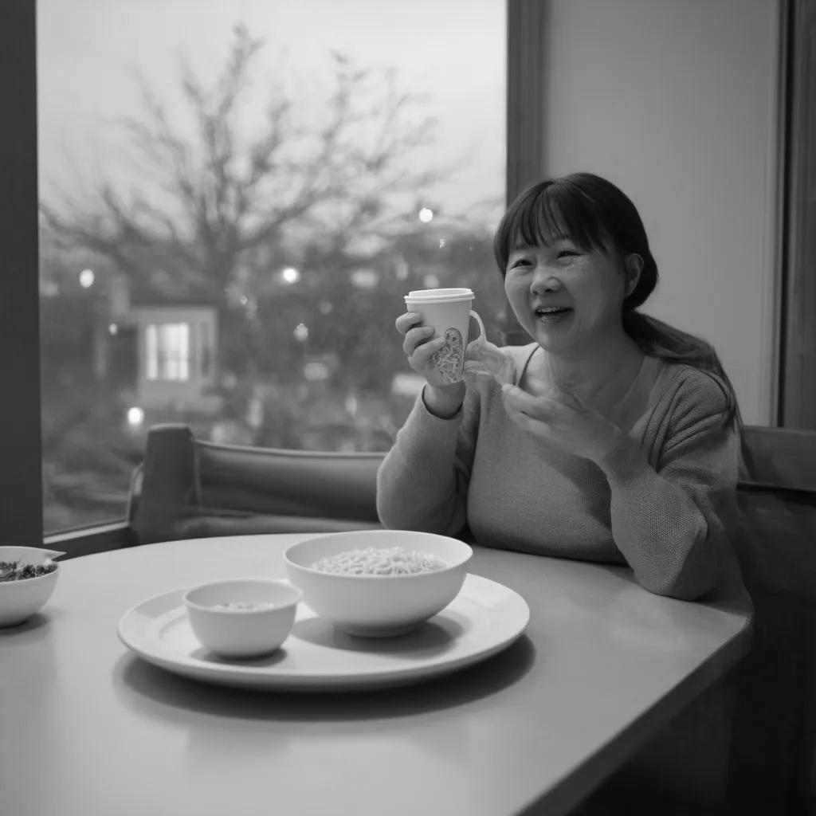
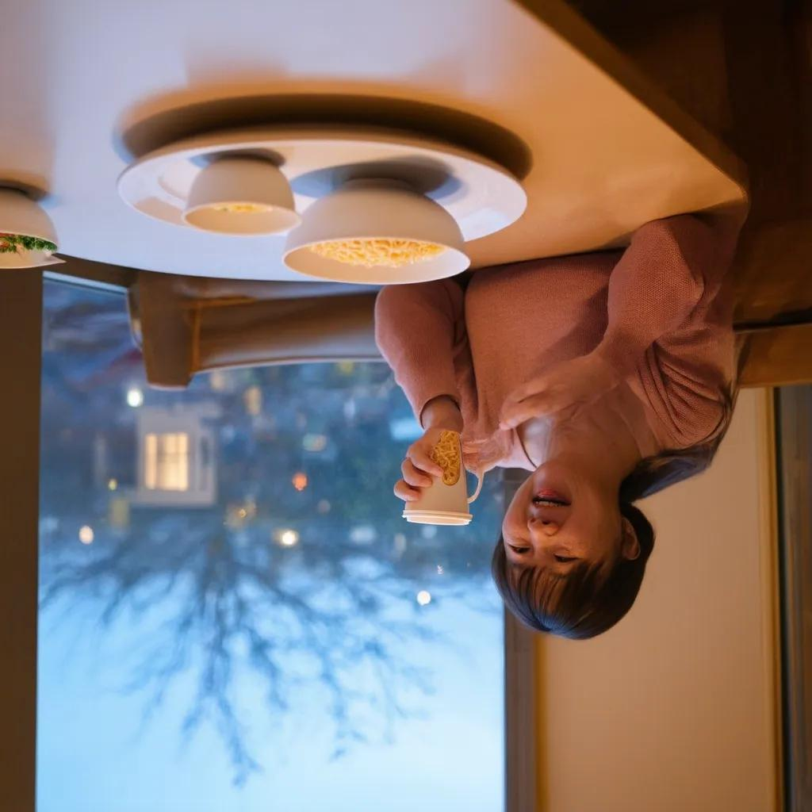
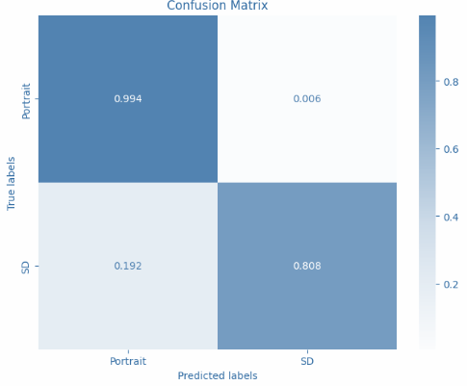
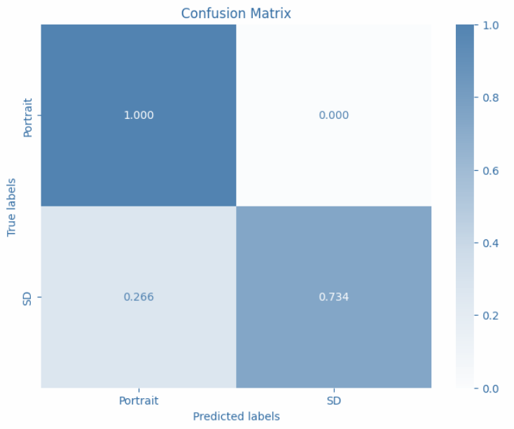
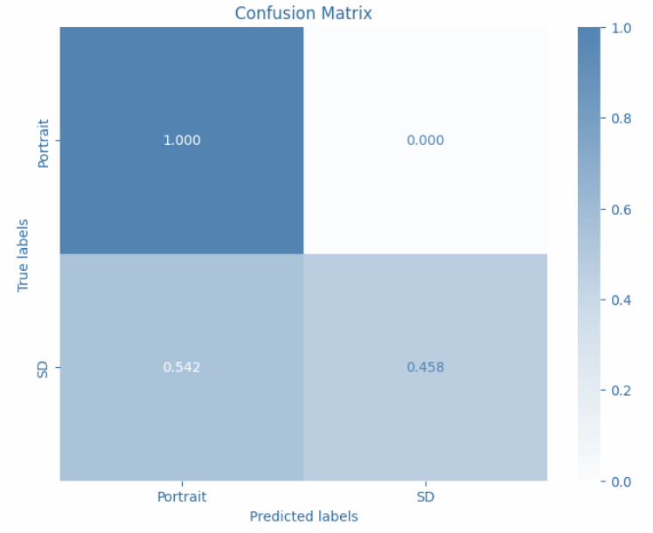
3 - Effective for Stable Diffusion
Edge Hance
Gray
Mirror Up
Correct Only:
96.83%
Total: 89.94%
Total: 86.49%
Total: 72.41%
(Only Correct)
(Only Correct)
(Only Correct)
0.994
1.000
1.000
0.808
0.734
0.458

Slide 27
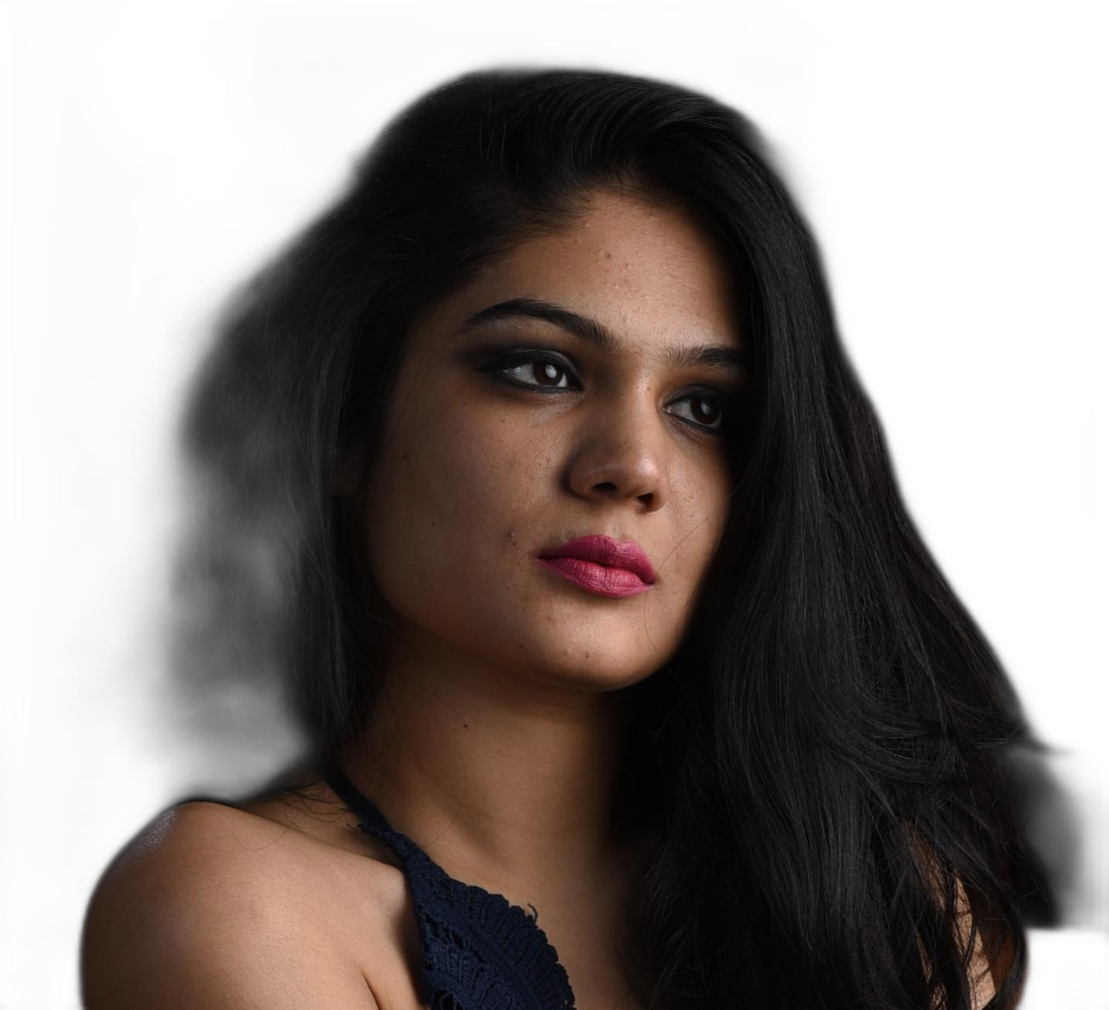
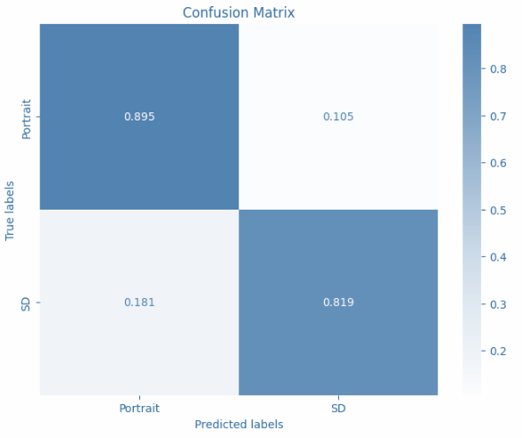
4 - Effective for Portrait
Remove Background
Correct Only:
96.83%
Total: 85.63%
(Only Correct)
0.895
0.819

Slide 28
Adjust Test Data
0.855
Ensemble Acc: 87.00%
Portrait: 85.5%
Stable Diffusion: 88.5%
0.885

Slide 29
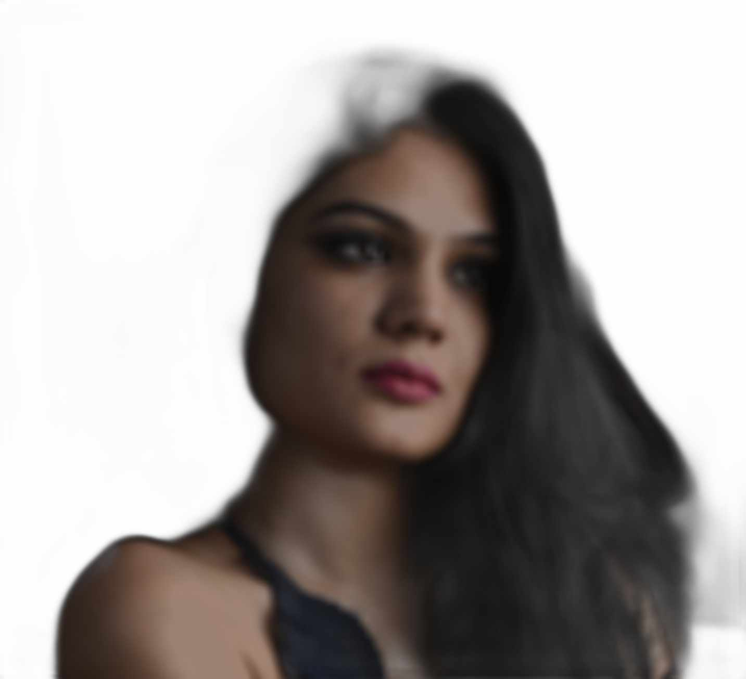
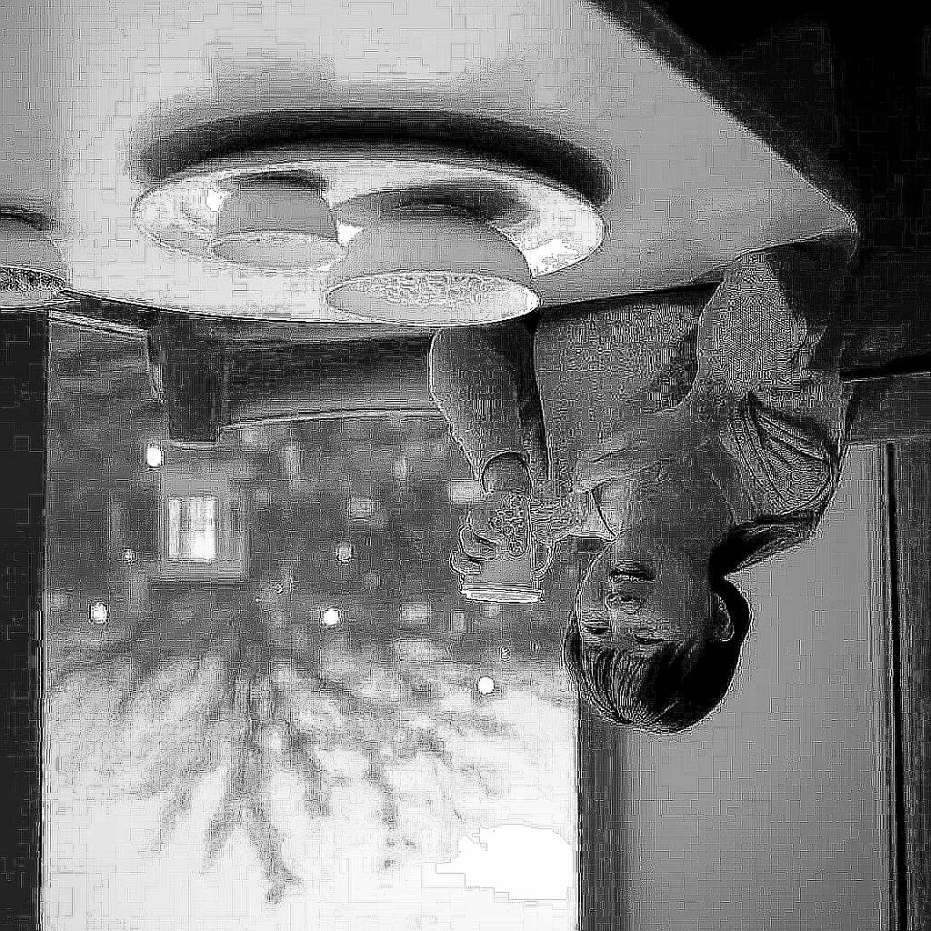

Remix for All Test Data
Total: 48.25%
0.960
Portrait
Contrast ↓
Highlight Shadow ↓
Colorless
Blur Smooth
Remove Background
45%
Stable Diffusion
Contrast ↑
Highlight Shadow↑
Colorful
Sharp Detail
Edge
Mirror up
Gray
45%
0.995

Slide 30



Best Test Data
Total: 87%
Total: 57.5%
85.5%
↓
0.820
Portrait
Contrast ↓
Highlight Shadow ↓
Colorless
Smooth
Remove Background
45%
Stable Diffusion
Contrast ↑
Highlight Shadow↑
Colorful
Sharp Detail
Mirror Up
45%
88.5%
↓
0.330

Slide 31


Conclusion
Like GAN Process
Recognition Team
Generation Team
To do more data pre processing
To train more models
To generate more various test data
Image to image function.. etc.

Slide 32


